Slide 1

IOT Workshop
Organised by KURC in collaboration with KUCC

Slide 2
Course Outline
Node MCU basics
Sensors and Data Fetching
Wi-fi and IOT
3rd Party Applications
IOT Project

Slide 3
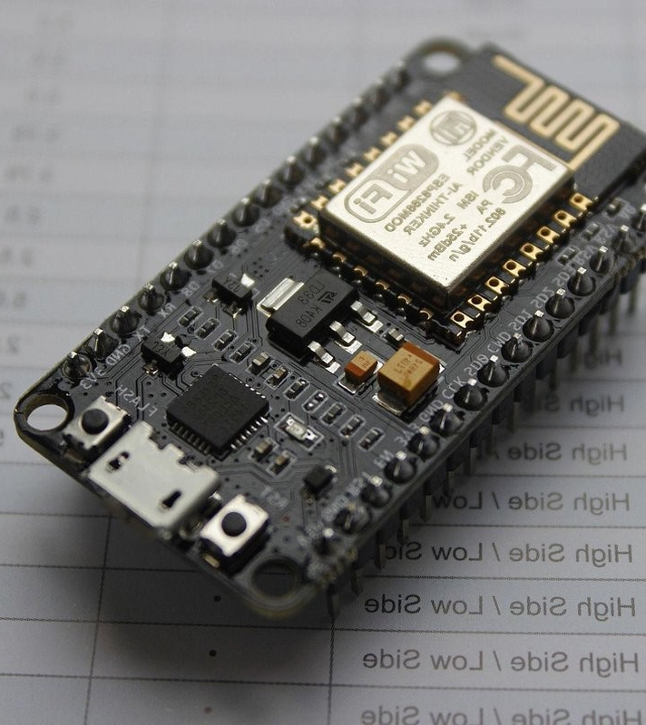
What is NodeMCU
NodeMCU is an open-source firmware and development kit that helps you to prototype or build IoT (Internet of Things) products.
The name "NodeMCU" combines "node" and "MCU" (micro-controller unit). Strictly speaking, the term "NodeMCU" refers to the firmware rather than the associated development kits.
NodeMCU is a versatile and powerful tool for anyone interested in creating IoT projects. Its integration with the ESP8266 module, combined with support for multiple development environments, makes it a popular choice among developers and hobbyists alike.
Introduction
Features
Comparison
Datasheet

Slide 4



Key Features
Wi-Fi Connectivity
The ESP8266 is renowned for its robust Wi-Fi capabilities, which allow it to connect to the internet and other devices seamlessly.
It supports all standard Wi-Fi protocols (802.11 b/g/n). This means it can join existing Wi-Fi networks or create its own.
GPIO The ESP8266 offers up to 17 GPIO pins, which can be used to interface with various external devices like sensors, LEDs, and other peripherals. These GPIO pins can be programmed to perform a wide range of functions
Power Management. It includes several power-saving modes, such as deep sleep, light sleep, and modem sleep. These modes allow the device to reduce its power consumption significantly when full operation is not required for battery-powered devices..
Features
Introduction
Comparison
Datasheet

Slide 5
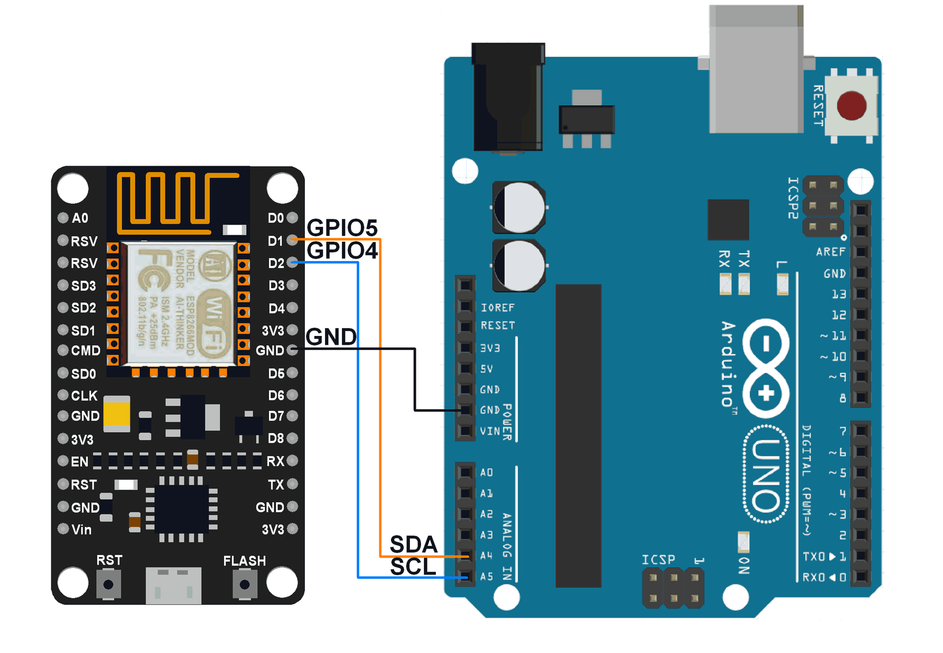
Arduino Vs NodeMCU
Arduino is ideal for beginners and projects that do not require Wi-Fi connectivity or high processing power. It's user-friendly and has extensive community support and accessories.
Wifi connectivity.
Processing power
Power consumption
Suitability for IOT
Comparison
Introduction
Features
Datasheet

Slide 6

Board Comparison
Arduino
-Clock speed 16 MHz
-Operates at 5V
-No built in wifi
-No inbuilt sensors
ESP 8266 -Clock speed 160 MHz
-Operates at 3.3V (voltage regulator)
-Built in Wi-Fi
-No inbuilt sensors
ESP 32 -Clock speed 240 MHz
-Operates at 3.3V(voltage regulator)
-Built in Wi-Fi and Bluetooth, BLE
-Has Inbuilt sensors (Temp, Hall effect, Capacitive touch)
Comparison
Introduction
Features
Datasheet

Slide 7

Applications
Home Automation: Smart lights, thermostats.
IoT Projects: Sensor networks, data logging.
Prototyping: Rapid development for new products.
DIY Projects: Personal projects for learning and innovation.
Comparison
Introduction
Features
Datasheet

Slide 8
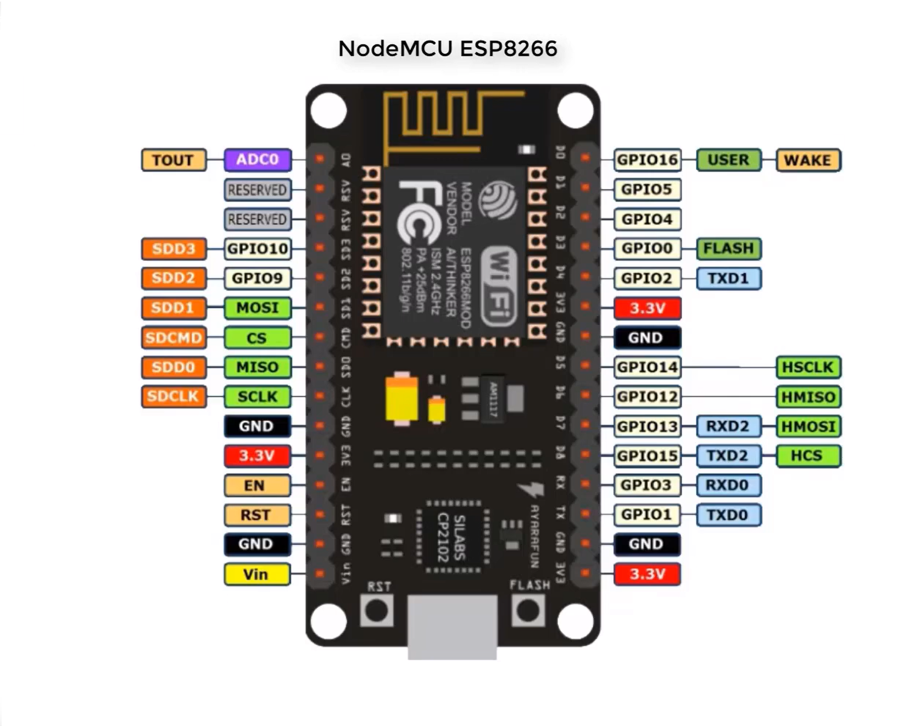
Datasheet ESP8266 -GPIO pins -3.3v -GND -Analog Pin -Reset and Flash -UART
Datasheet
Introduction
Features
Comparison

Slide 9
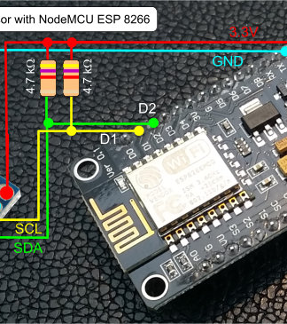
Setup Arduino IDE
Connect ESP8266
Make sure device is detected
Setup Boards manager link
Add esp8266 board from board manager
Choose port and board
Upload code

Slide 10
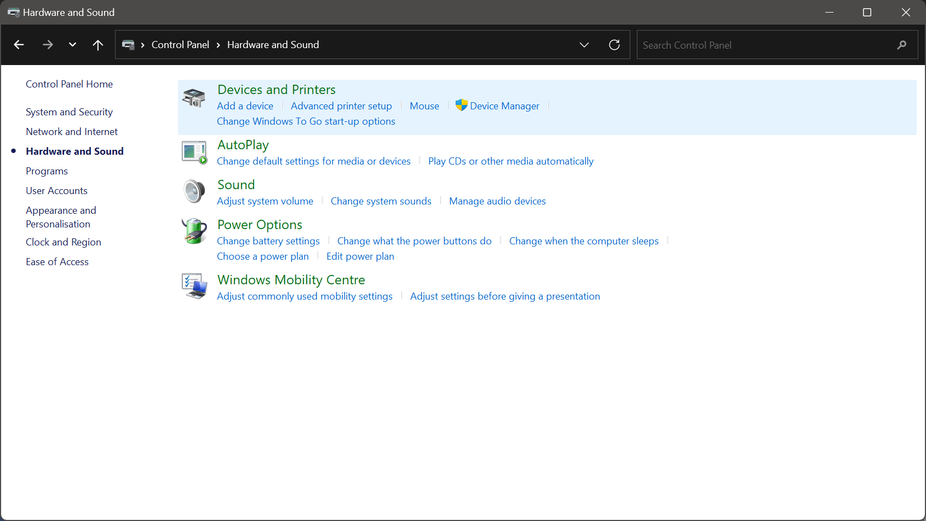
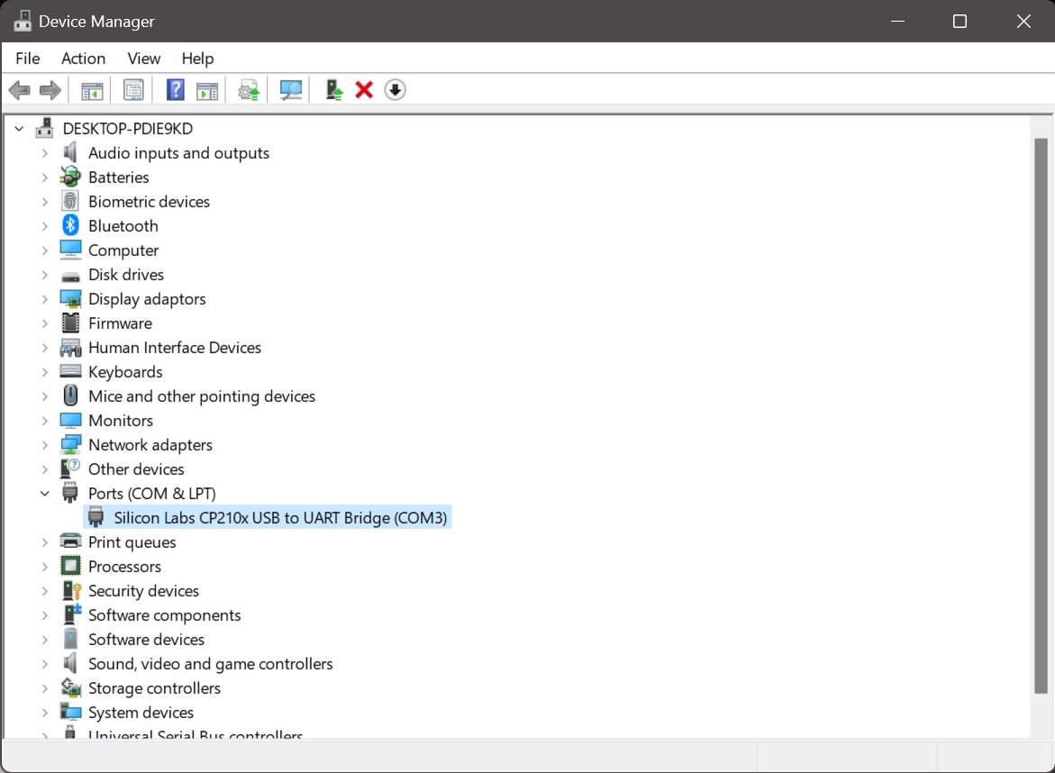
Go to device manager
Step 1 : Check Connection
Check for Board

Slide 11
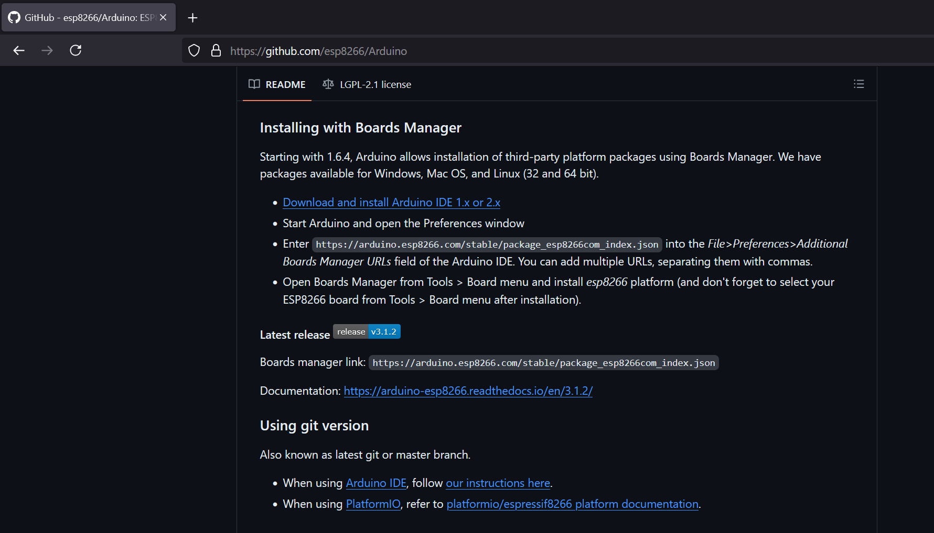
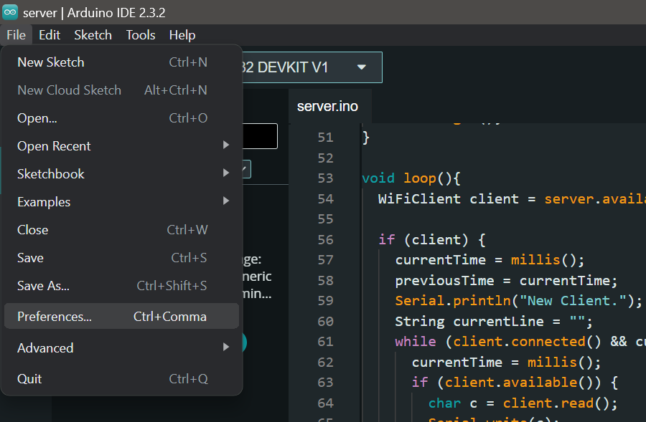
Link: github.com/esp8266/Arduino
Step 2 : Setup boards manager
Go to file->preferences

Slide 12
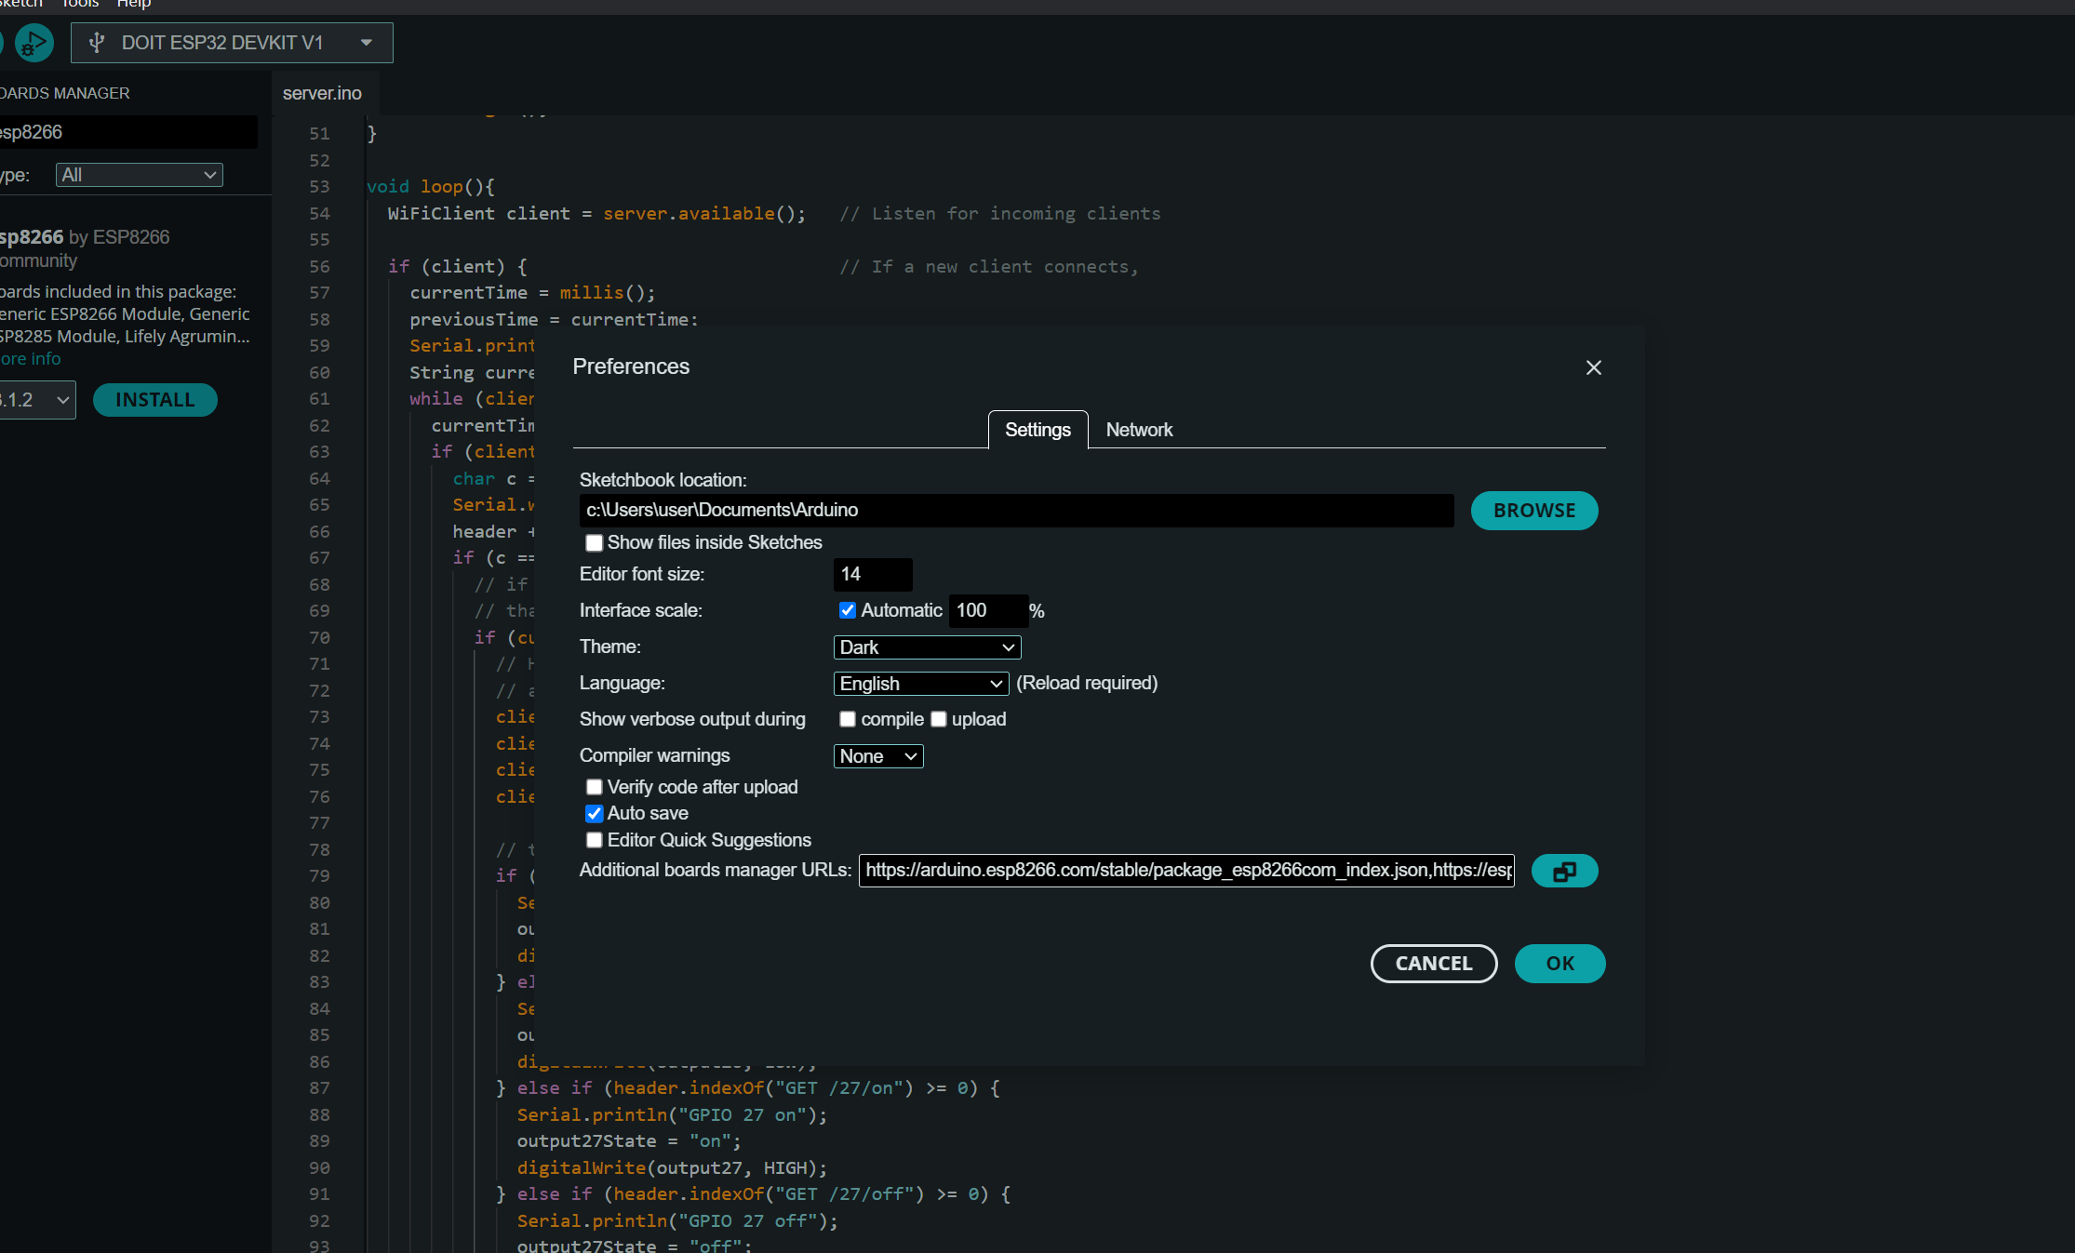
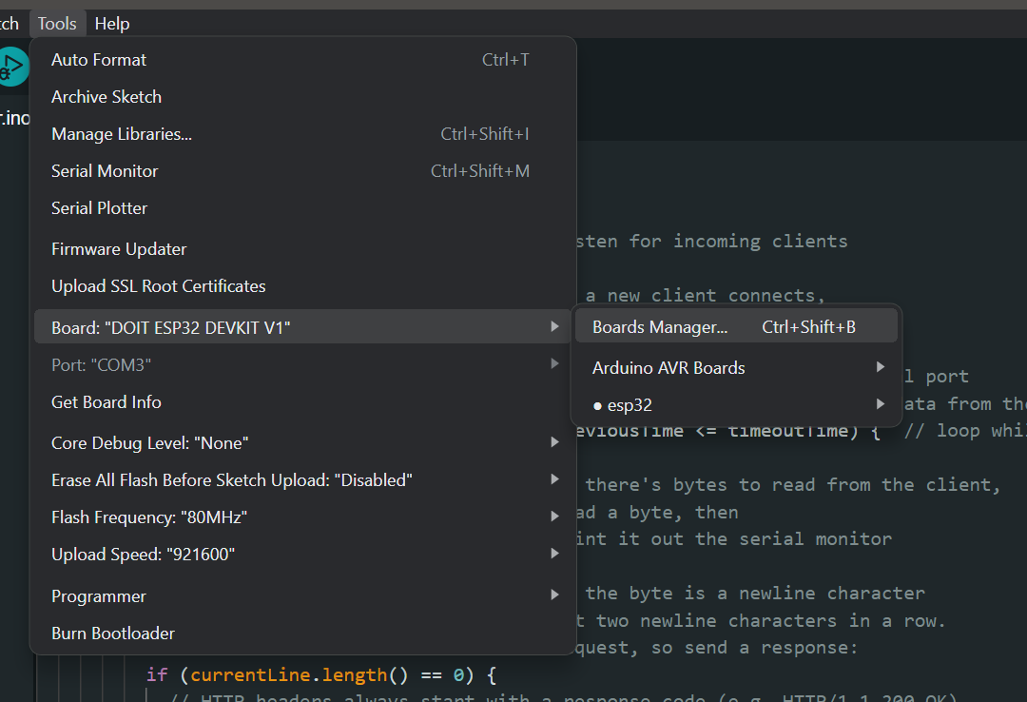
Paste link from github to “additional boards manager”
Step 2 : Setup boards manager
Go to Tools-> Board-> Boards Manager

Slide 13
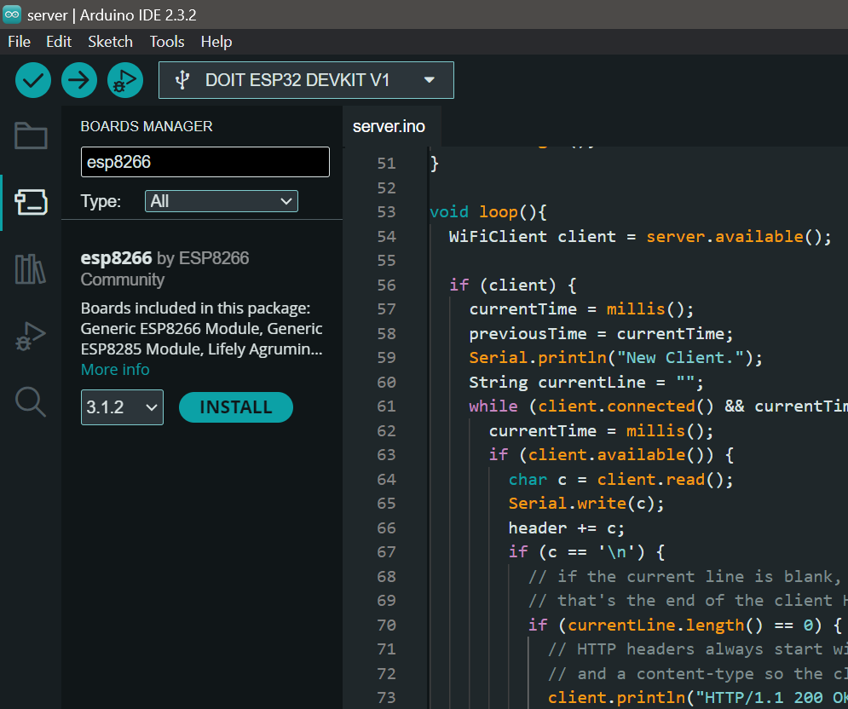
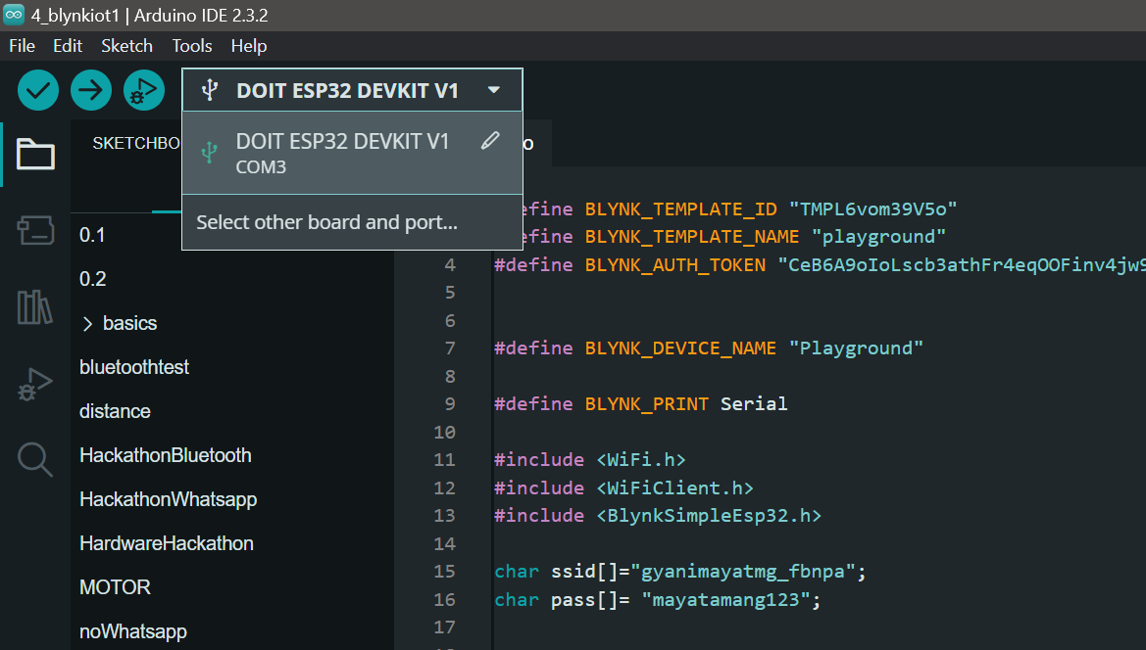
Search for esp8266 and Install
Step 3 : Choose port and board
Go to boards dropdown ->select other board and port

Slide 14
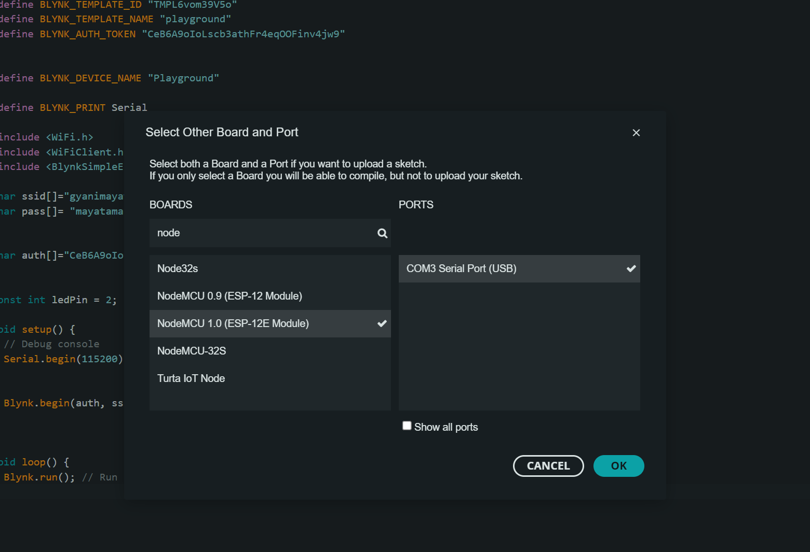
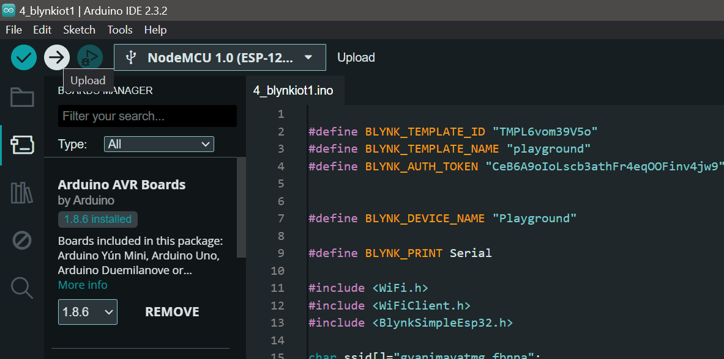
Search for NodeMCU 1.0 and select
Step 3 : Choose port and board
Click upload to upload your code

Slide 15
Blinking LED
Your first task will be to build a blinking LED setup using NodeMCU
The most basic code one can write in Arduino
Blinking LED is practically printing “Hello world” but for hardware
The NodeMCU has an inbuilt led that can be accessed using LED_BUILTIN or GPIO 2.

Slide 16
Blinking LED
To understand basic Arduino programming, you need to understand the basic structure.
Libraries are used by the #include keyword and are at the top of program
void setup{}
void setup{} is used to define pinModes, setup serial communication, initialize libraries, and setting initial state
void loop{}
The loop() function contains the main code that runs repeatedly after the setup() function has completed. Used to read sensors, control actuators, implement logic and control

Slide 17
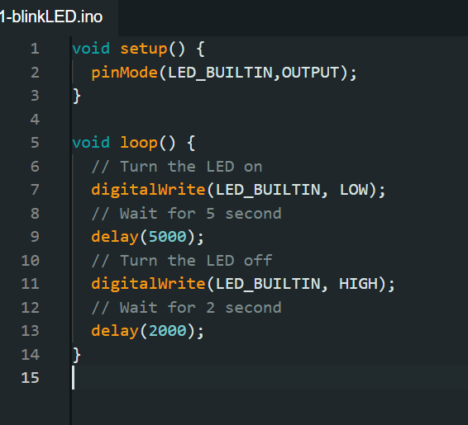
Simple Blinking LED
This simple code toggles the built-in LED on and off with a one-second interval, demonstrating how to control digital outputs on the ESP8266. By using pinMode and digitalWrite, you can manipulate the state of pins to create various interactive projects.

Slide 18
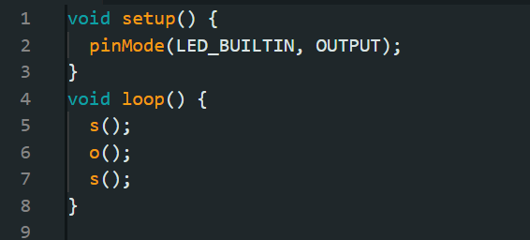
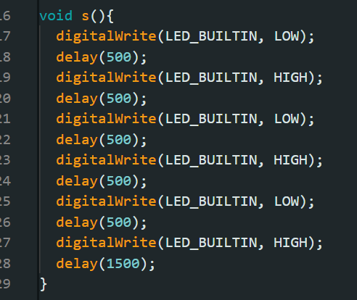
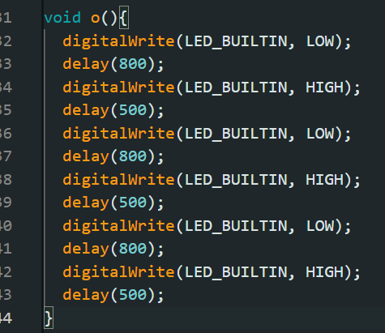
Setup and loop
Modification: SOS signal
User defined functions

Slide 19

Serial Monitor
The Serial Monitor is a feature in the Arduino IDE that allows you to send and receive data between your Arduino board and your computer.
Commonly used for debugging, displaying sensor readings, and communicating with the Arduino.
Initialize using Serial.begin(baudRate);
Serial.print(): Prints data without a new line.
Serial.println(): Prints data followed by a new line.
Read using Serial.read() and Serial.available()

Slide 20
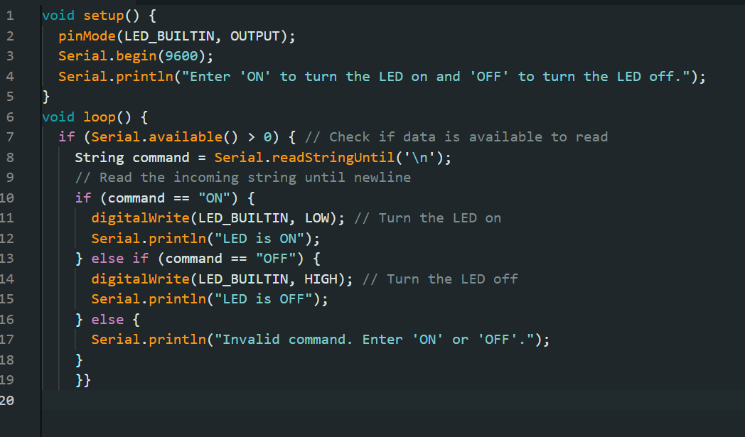
Blink LED using commands
This simple code toggles the built-in LED on and off with a one-second interval, demonstrating how to control digital outputs on the ESP8266. By using pinMode and digitalWrite, you can manipulate the state of pins to create various interactive projects.

Slide 21
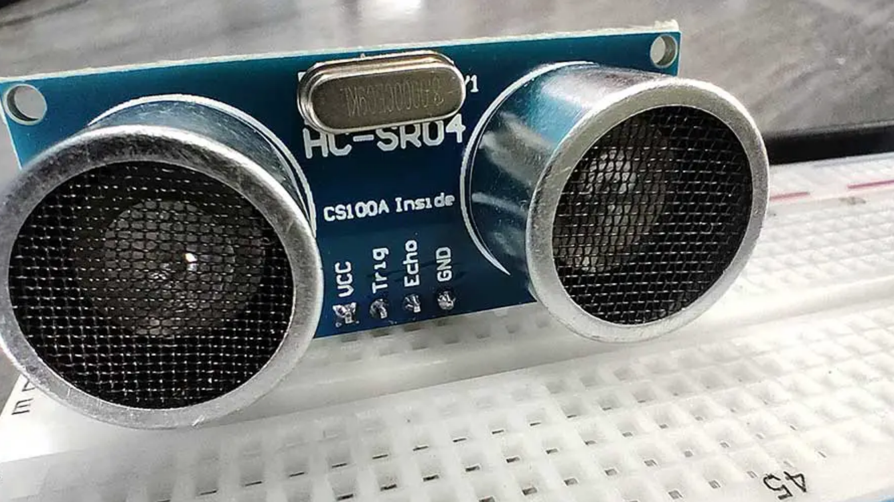
Ultrasonic sensor
An ultrasonic sensor measures distance by using ultrasonic waves. It emits a sound wave at a frequency above the range of human hearing and measures the time it takes for the sound to bounce back from an object.
It relies on transmission, reception and distance calculation
Pin config is VCC, TRIG, ECHO, AND GND

Slide 22
How it works:
The sensor's transmitter (trigger pin) sends a high-frequency ultrasonic pulse.
The ultrasonic pulse travels through the air.
When it hits an object, it reflects back towards the sensor.
The sensor's receiver (echo pin) detects the reflected wave.
The echo pin goes HIGH and stays HIGH for the duration of the time it takes for the pulse to travel to the object and back.

Slide 23
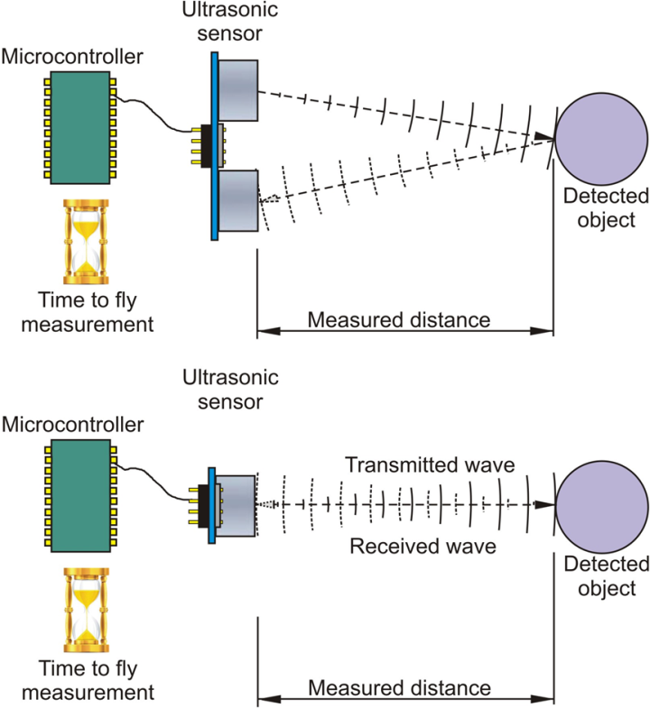
Distance calculation
Distance=2Time×Speed of Sound​
The speed of sound in air is approximately 343 meters per second (0.0343 cm/μs).
Distance is calculated using the formula:
Distance=(Time taken × Speed of Sound)/2
The division by 2 accounts for the pulse traveling to the object and back.
Distance = (time in μs×0.0343 cm/μs​)/2

Slide 24
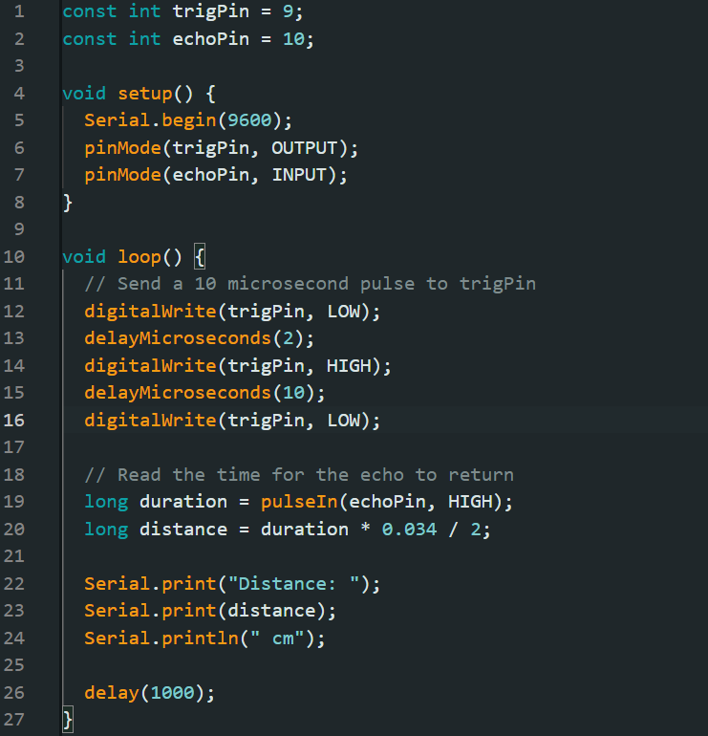
Distance calculation
By sending an ultrasonic pulse and measuring the time it takes for the echo to return, the distance to an object can be calculated and displayed on the Serial Monitor.
Trigger sensor
Measure echo duration
Calculate distance
Display distance

Slide 25
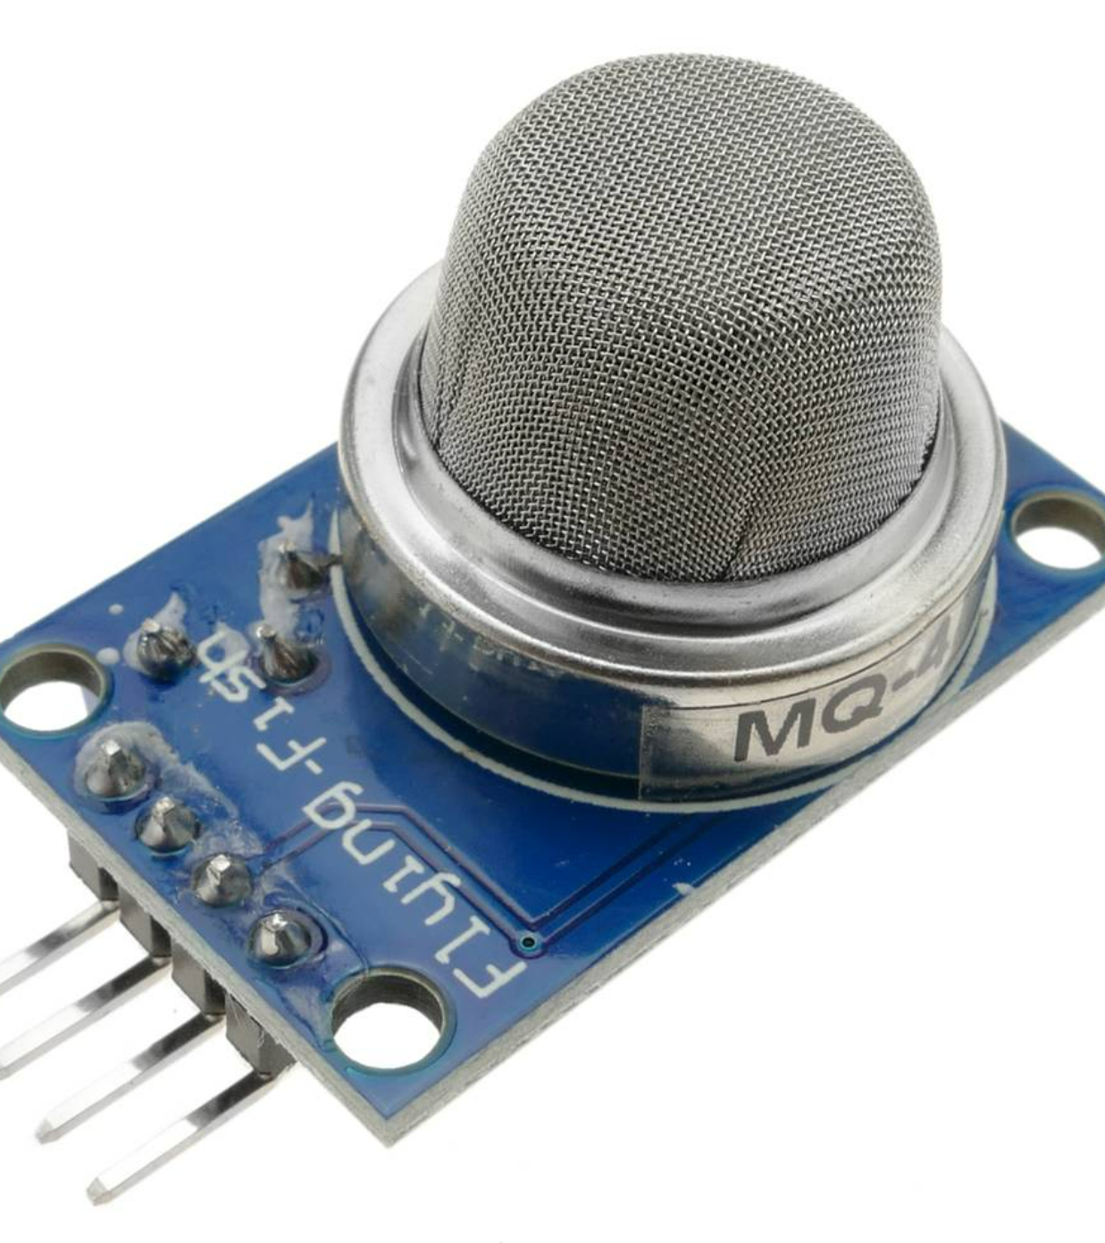
MQ sensors
Working Principle
Heating the Sensing ElementHeater Coil: Brings the sensor to an optimal temperature for detecting gases.
The sensing element interacts with the gas molecules. The presence of target gases alters the resistance of the chemical layer on the sensing element.
The change in resistance is converted into an analog signal.
The analog signal can be read and processed by a microcontroller to determine gas concentration.

Slide 26
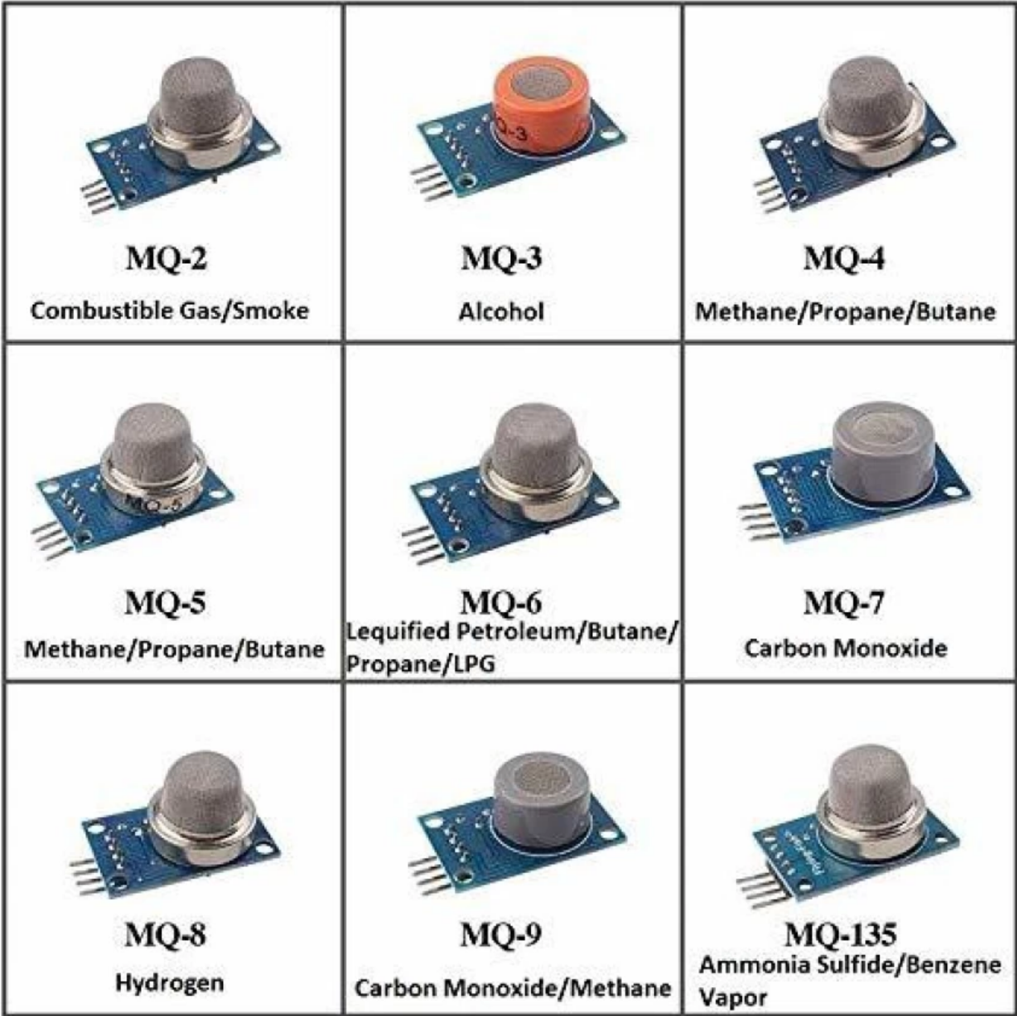
Types of MQ sensor
MQ sensors are a series of gas sensors used for detecting various gases in the air.
We will be using MQ-2 sensor in the following session.
MQ-2 Detects: LPG, Methane, Hydrogen, Smoke

Slide 27
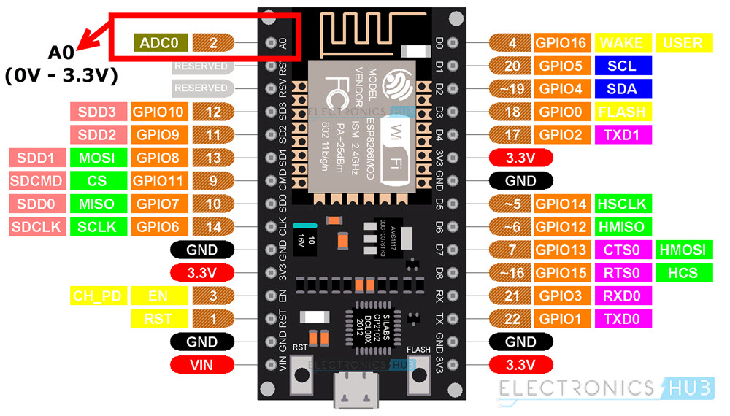
Analog pin
The ESP8266 has only one ADC pin, labeled as A0 or ADC0.
The ADC on the ESP8266 is a 10-bit ADC. This means it can represent the input voltage with 1024 discrete levels, ranging from 0 to 1023.

Slide 28
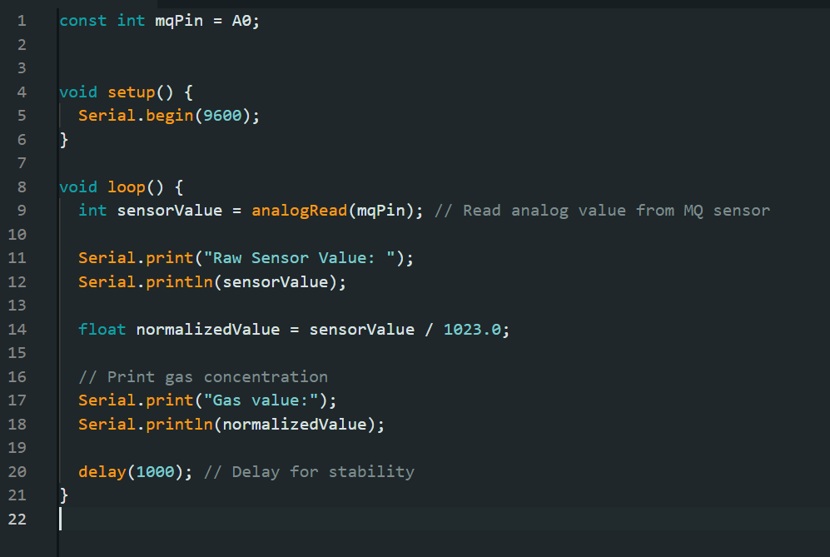
MQ sensor
The analogRead(mqPin) function reads the analog value from the sensor.
The sensor measures voltage in scale of 0 to 1023 so dividing it by 1023 gives it range of 0 to 1
The gas value is measured.
Modify this code to display warning when gas value is high.

Slide 29
End of Day 1
Organised by KURC in collaboration with KUCC

